Slide 1



City & Cuisine-Based Restaurant Recommender Using Yelp Dataset
z

Slide 2

School of Computer Science And Engineering
Data Mining and Analysis(18ECSC301)
Course Project
on
Yelp Data Challenge
Round 12
Team Leader: Adarsh Raj
Team Members:
Abhijeet Prakash
Abhishek Sawant
Adarsh Raj
Apeksha Ninnekar

Slide 3

INTRODUCTION TO CHALLENGE
Yelp's website, Yelp.com, is a crowd-sourced local business review and social networking site active in major metropolitan areas.
.
Yelp users can submit a review of their products or services using a one to five star rating system.
Yelp has over 135 million restaurant and business reviews worldwide.

Slide 4
Description
Yelp has 135 millions restaurants worldwide.
Whether you’re looking for a continental food, a great coffee shop nearby, a new salon, or the best handyman in town, Yelp is your city guide to finding the perfect places to eat, shop, drink, relax, visit and play.
Problem statement
“To search for and recommend best restaurants in a city for different kinds of cuisines based on reviews given by customers .”

Slide 5
Project vision
Yelp contains review data of various restaurants in a city and helps users in choosing a restaurant.
In this project we have used review text for recommending restaurants to the users for different cuisines.
We have investigated features of yelp data for rating prediction and recommendation tasks

Slide 6
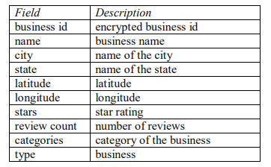
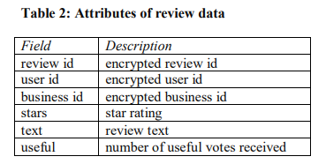
Dataset
The size of the Data is 6.84 Gb including the sub files
Business Dataset(139 Mb)
Check-In Dataset (50.3 Mb)
Photo Dataset (34.9 Mb)
Review Dataset (4.39 Gb)
Tips Dataset (203 Mb)
Users Dataset (2.03 Gb)
Attributes of Business data
Data sets used :
Business
review

Slide 7
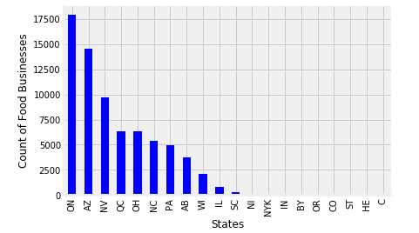
Exploratory analysis
Graph to check no of food businesses in each state .
Conclusion: Number of businesses for food categories was highest in Ontario state i.e. 17907 businesses

Slide 8
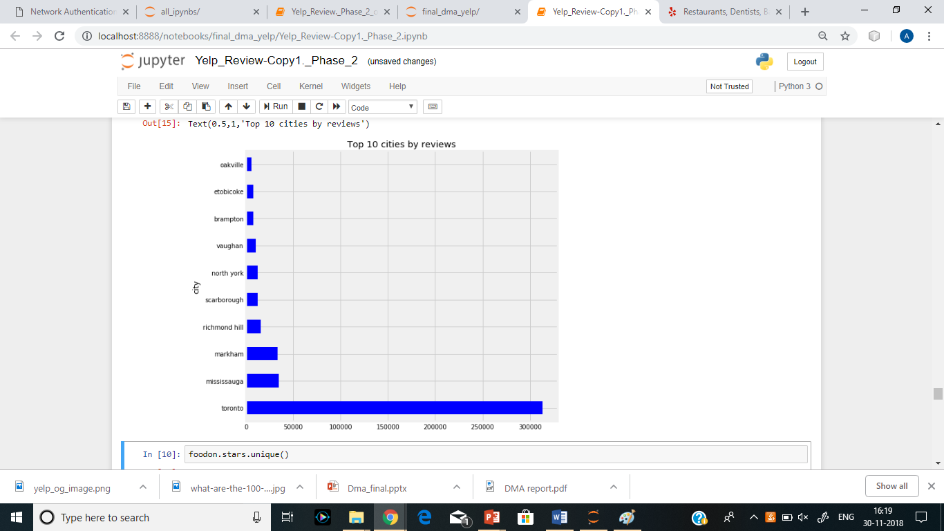
Exploratory analysis
Top 10 cities with highest review ratings in Ontario state.

Slide 9
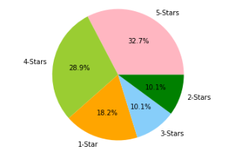
Exploratory analysis
Majority of the stars for food business are 5-stars

Slide 10
Categories selected
Over all food categories:
‘Food’, ' Restaurants’, 'Pizza', 'Mexican', 'American (Traditional)', 'American (New)', 'Italian', ''Indian', ' Pakistani', 'Thai', ' Japanese', 'French’,’ Canadian (New ), ' Middle Eastern', 'German', 'Vietnamese', 'Chinese', 'Hungarian'
Cuisines:
Indian
Chinese
Thai
Italian
Japanese

Slide 11
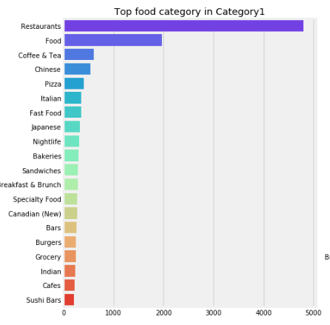
Exploratory analysis
Majority of the food categories selected was restaurant .

Slide 12
Data Reduction
After exploratory analysis , we trimmed our dataset:
We selected instances with:
Food related businesses
State as ‘ Ontario’

Slide 13
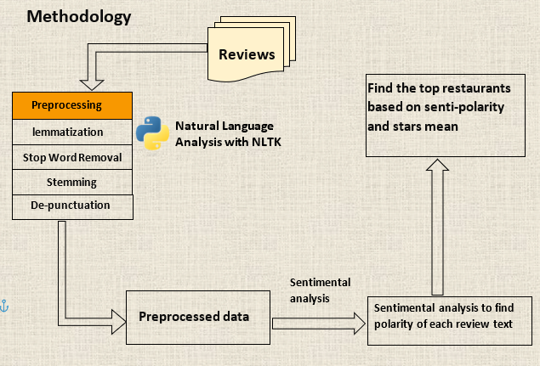
Methodology

Slide 14
Pre processing
Dropped :
28 columns from business file
4 columns from review file
Adding new columns: senti-polarity and text clear
Data integration:
Combining the two dataset : business and the review the total no of columns after integration is 36 columns and 482384 rows

Slide 15
Predictive tasks
There are two major tasks in our project:
Predict rating from review text:
- Linear support vector machine classifier
Find the sentiment polarity and recommend the top best restaurants for each cuisine type.
– Sentiment polarity
- Mean of star ratings

Slide 16
Linear support vector machine
’ Linear support vector machine classifier
text pre-processing
removed punctuations, stop words and tokenized the reviews
converted each review into a vector using tf-idf
Training the model
split the dataset into training and test set by 80:20 ratio
build a multiclass svm classifier and fit it to our training set
Test and evaluating the model
tested the model for 5 classes(1,2,3,4,5 rating)
using 5 classes(1,2,3,4,5)

Slide 17
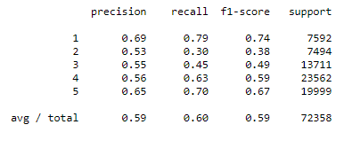
Using five classes(1,2,3,4,5)
’

Slide 18
Task2: Recommending Restaurants To Users
’
Calculate sentiment polarity for each review text
Find mean sentiment polarity for each business_id
Find mean stars for each business_id
Considering the business with mean stars greater than 3.5 and sentiment polarity greater than 0 as good restaurants.

Slide 19
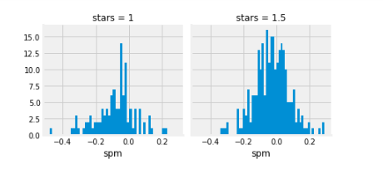
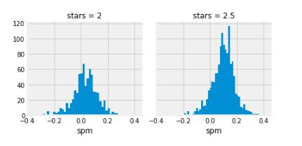
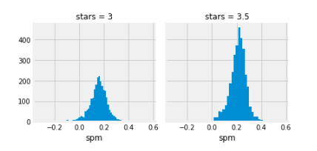
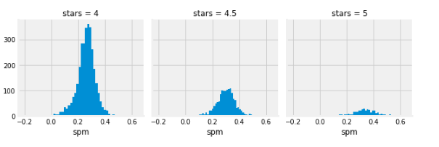
Plotting graphs of stars vs sentiment polarity
From graph we see that all the stars greater than 3.5 are above 0 of senti-polarity.
’

Slide 20
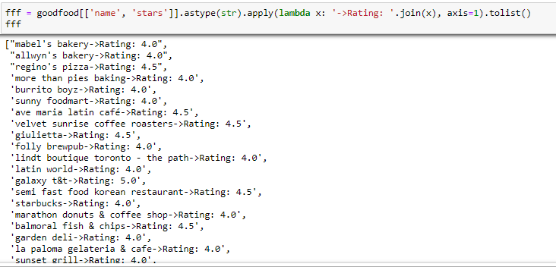
Displaying restaurants on map

Slide 21
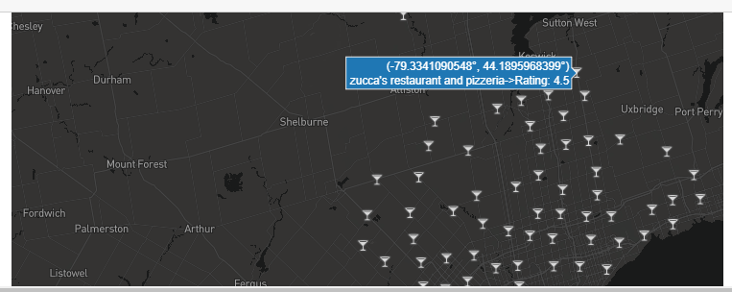
Mapping the restaurants on world map

Slide 22
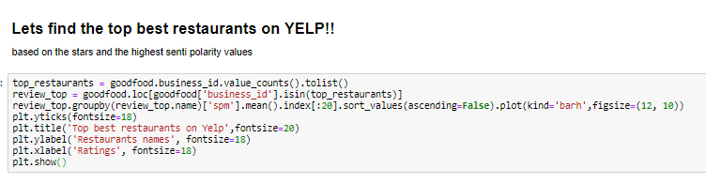
Finding the best restaurants
Finding the top best restaurants on YELP:
based on the stars and the highest senti polarity value

Slide 23
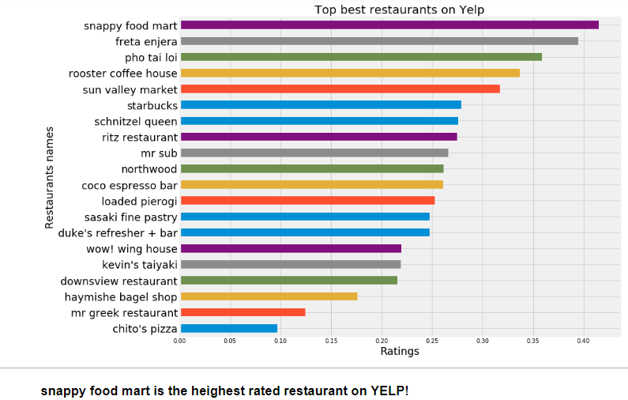
’

Slide 24
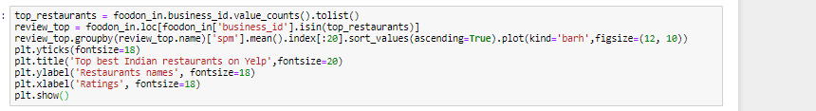
Indian cuisine
Finding top restaurants for Indian cuisine.

Slide 25
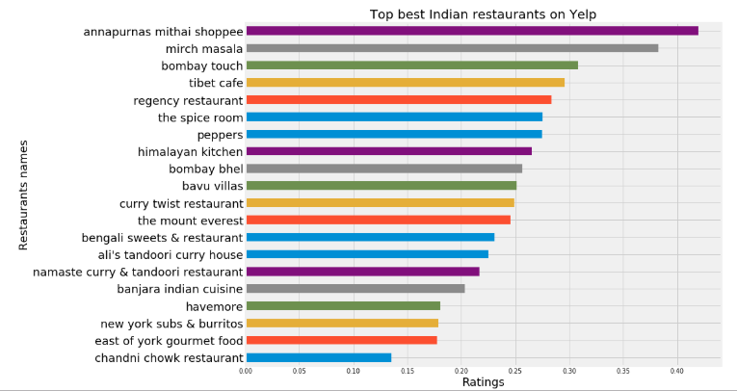
’

Slide 26
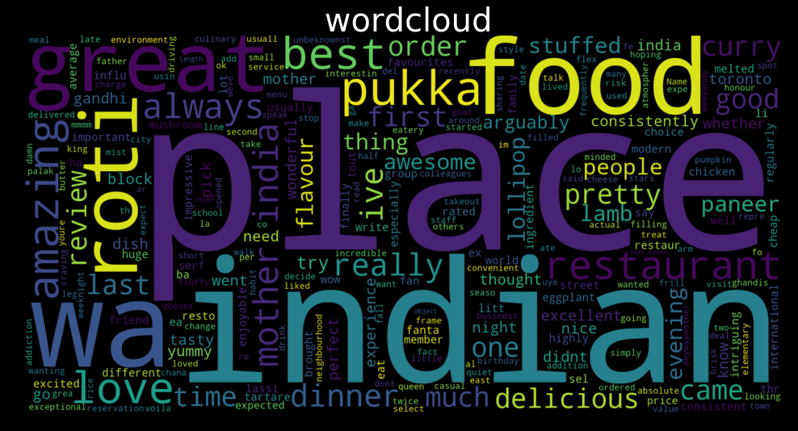
WORDCLOUD

Slide 27
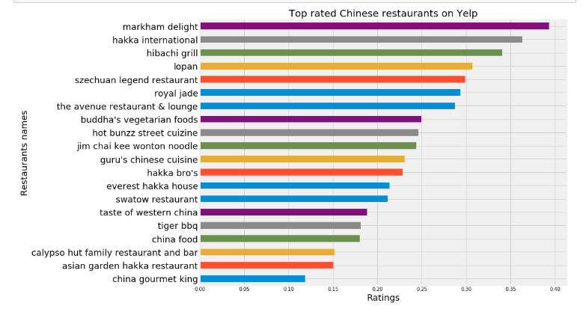
Chinese cuisine
Finding the top best restaurants for Chinese cuisine.

Slide 28

GUI

Slide 29
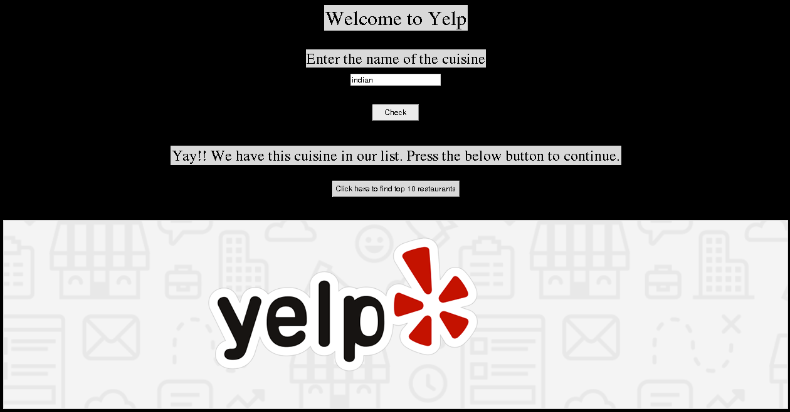
GUI

Slide 30
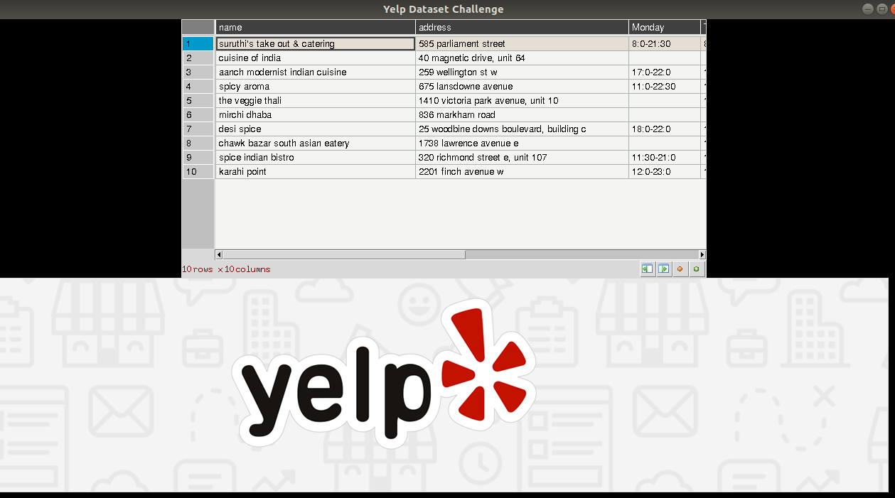

Slide 31
Thank you

